Slide 1
Text Sequence Synthesis
Katie Lewis
kmlewis@mit.edu

Slide 2
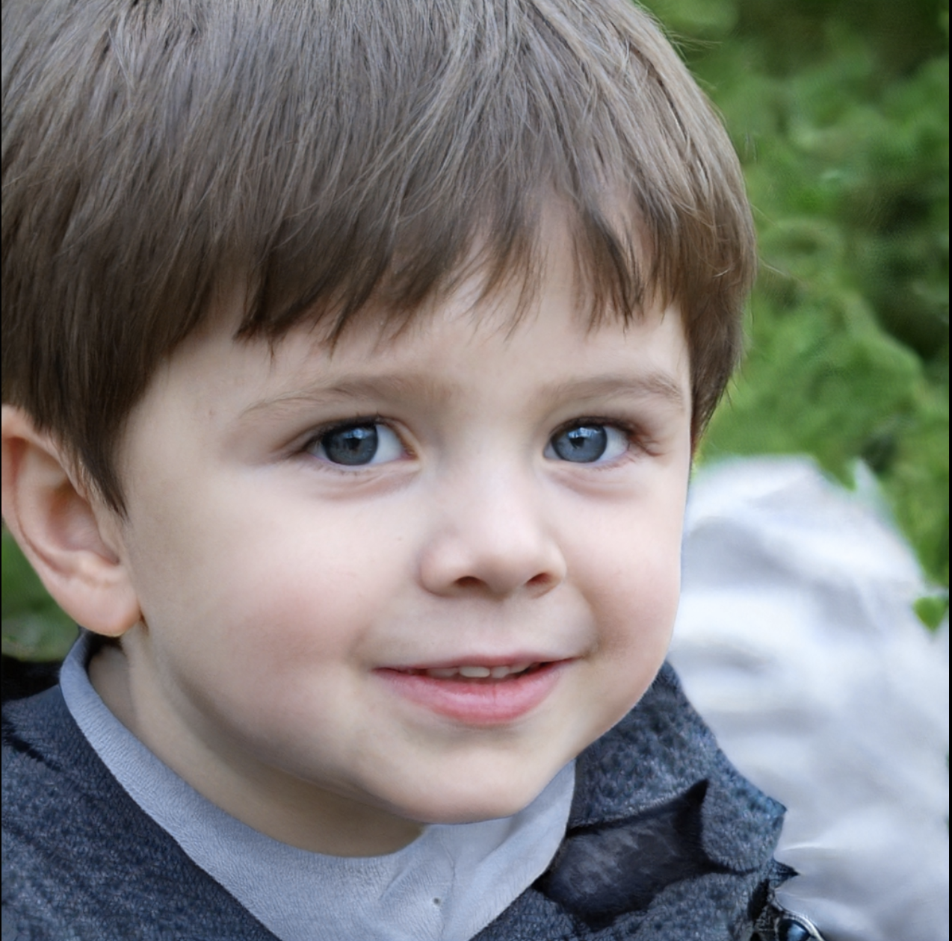
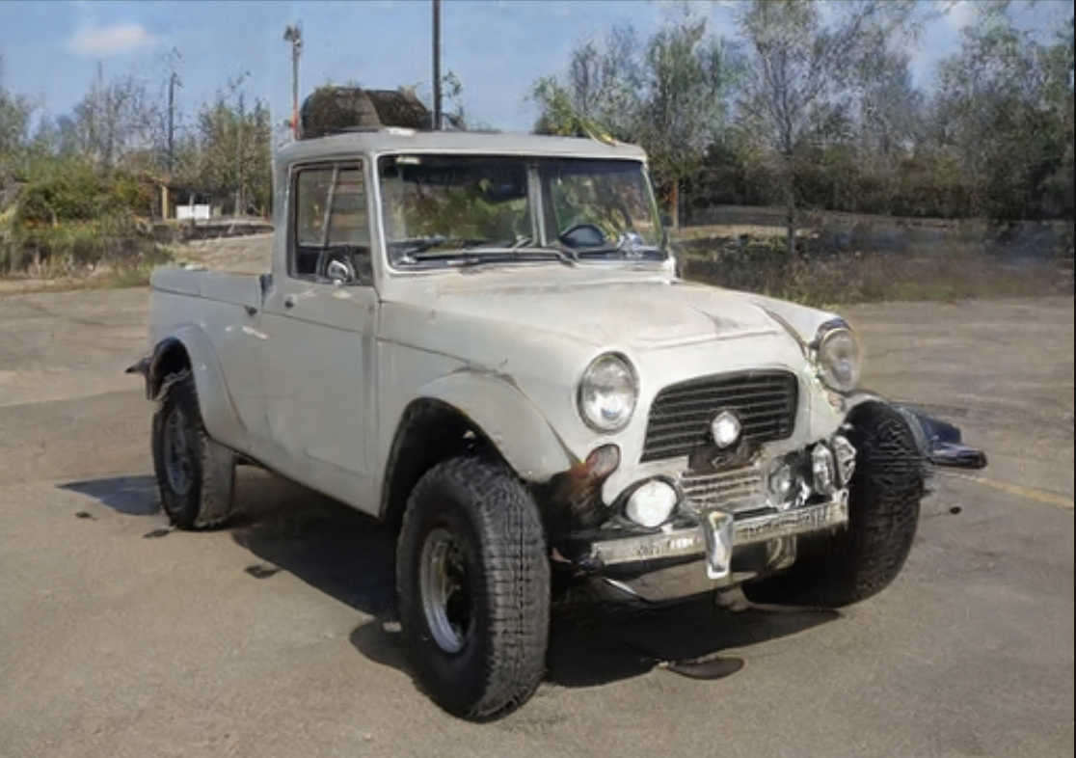
Photorealistic GAN Outputs
thispersondoesnotexist.com
thisautomobiledoesnotexist.com

Slide 3
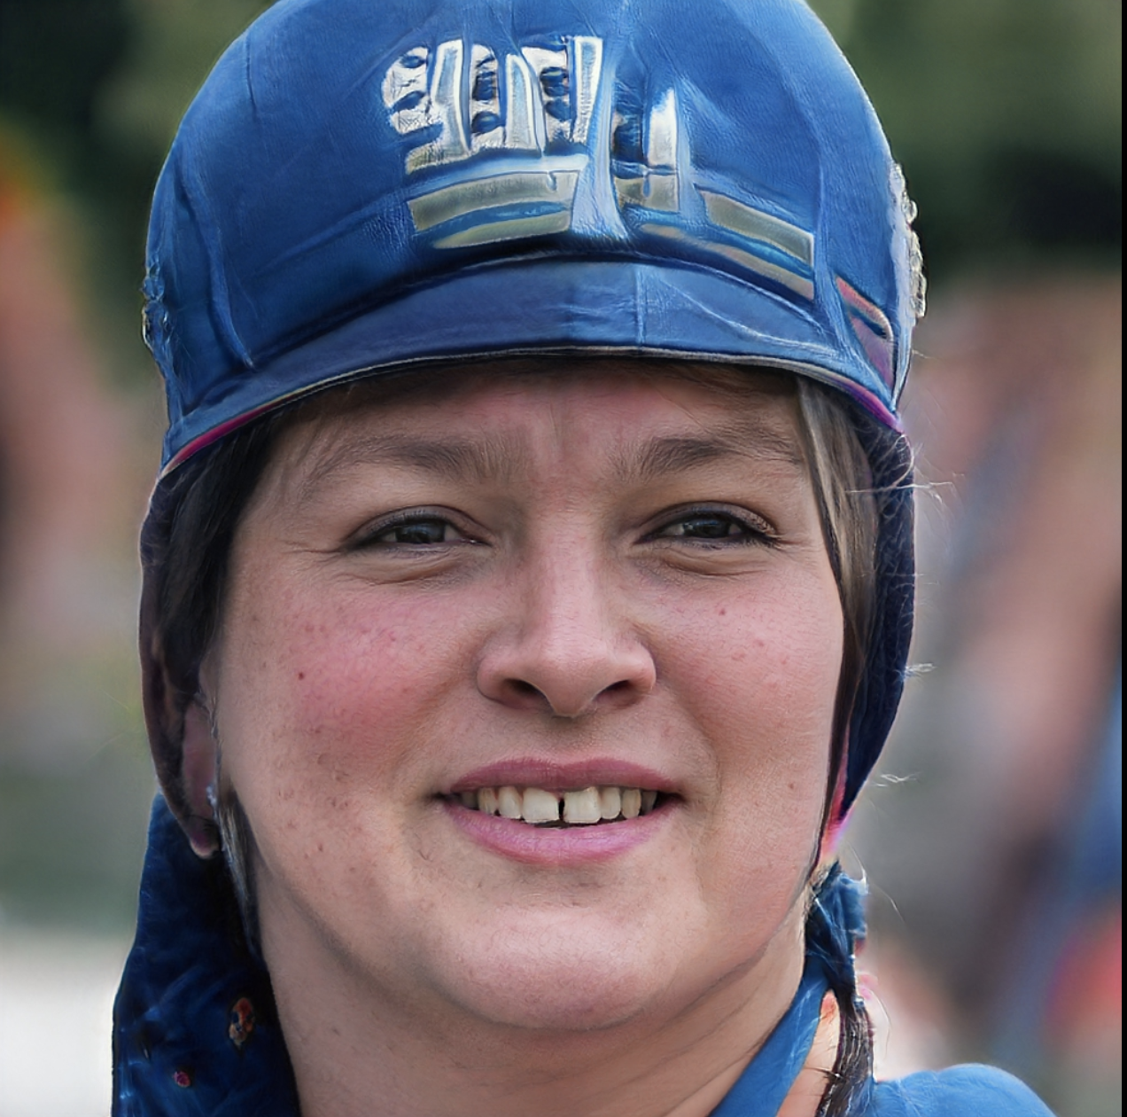
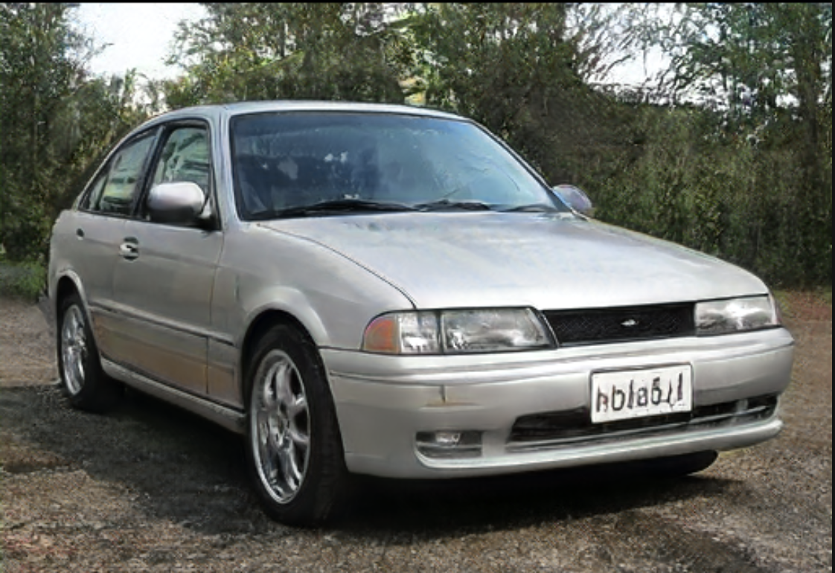
Not-so-Photorealistic GAN Outputs
thispersondoesnotexist.com
thisautomobiledoesnotexist.com
Notes:
Talk about applications – autonomous driving (need text on signs) – visualizing designs (e.g. storefronts)
Dataset generation & creativity/graphic design

Slide 4
Observations and Motivation
GANs do not generate legible text in many scenes
Humans are especially sensitive to incorrect text
Can we generate sequences of text (more than one character) in different styles?

Slide 5
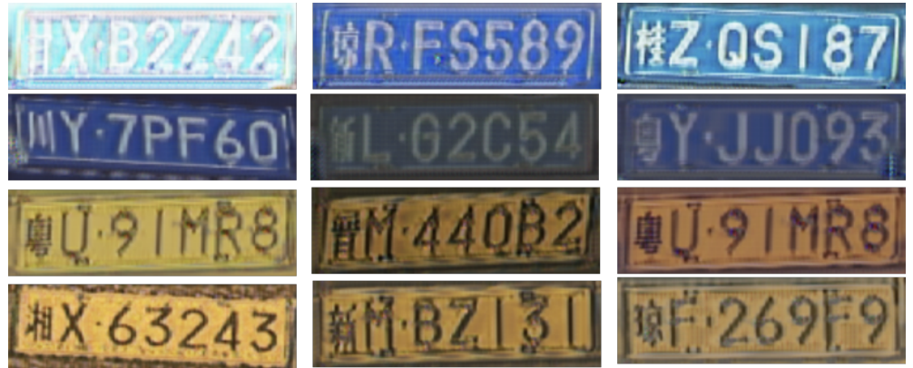
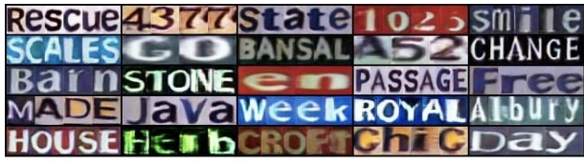
GAN Text Rendering Existing Work Examples
License Plates
Alpha-numeric Dataset
Wang, Xinlong, et al. "Adversarial generation of training examples: applications to moving vehicle license plate recognition." arXiv preprint arXiv:1707.03124 (2017)
Fang, Shancheng, et al. "Learning to Draw Text in Natural Images with Conditional Adversarial Networks." IJCAI. 2019.
Notes:
Include signatures --- not much signatures
Talk about generator & discriminator

Slide 6
Conditional WGAN-GP
Synthetic dataset
alphabet size, 26
sequence length, n
Labels for conditioning are 26*n vectors with n values set to 1
Provides feedback on each character and the ordering of characters
Generator
All convolutional
Concatenate noise vector (dimension of 26) with label
Critic
Run the labels through linear layer & concatenate with input image
WGAN-GP loss
Gulrajani, Ishaan, et al. "Improved training of wasserstein gans." arXiv preprint arXiv:1704.00028 (2017).
Arjovsky, Martin, Soumith Chintala, and Léon Bottou. "Wasserstein generative adversarial networks." International conference on machine learning. PMLR, 2017.

Slide 7


Conditional Text Generation
Training
Images contain randomly sampled 2 letter sequences
4 font choices, 2 font color choices, all lowercase
35,000 images

Slide 8
Conditional Text Generation
Training
Images contain randomly sampled 4 letter sequences
Four font choices, six font color choices, all lowercase
Testing
Condition on four-letter words that do not appear in training set

Slide 9


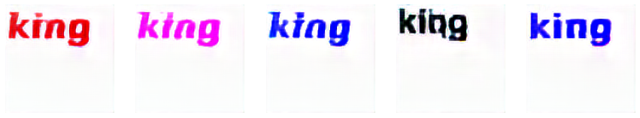



Conditional Text Generation

Slide 10

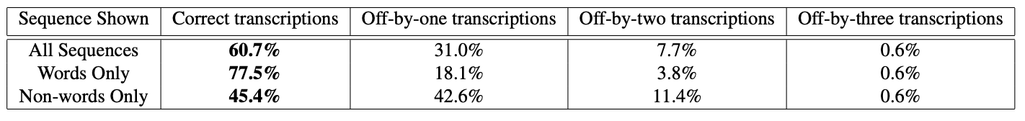
User Study
16 participants asked to transcribe text from GAN images
Shown 5 examples of 21 random sequences that do not appear in training set
10 words and 11 non-words
1 repeat question (answer only counted once)

Slide 11



Failure Cases
“pipe”
“free”
“mama”

Slide 12

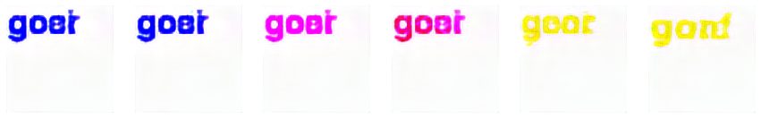

Interpolation in Latent Space

Slide 13
Future Work
Generate words of varying sequence length
Generate multiple words with varying newlines and spaces

